Slide 1

Housing & EU Finance 2020 – 2027
Perspective from the ground
Andres Jaadla
Chairman – EKYL
Housing Europe – board member

Slide 2

New start !

Slide 3




Housing Europe Ad Hoc Working Group
16th of April 2019 Tallinn
4th meeting of the Ad Hoc Working Group in support of countries with housing systems in transition
Which housing system to choose & how to finance?

Slide 4


XX Baltic Housing Conference 2019
Housing Europe helps to respond to requests for information from countries with housing systems in transition. It serves as a platform to bring together current or former experts from within Housing Europe Members and experts recommended by Members from e.g. academia or other entities specialising in housinghttps://www.eugreenweek.eu/en/partner-events/10th-baltic-housing-conference

Slide 5
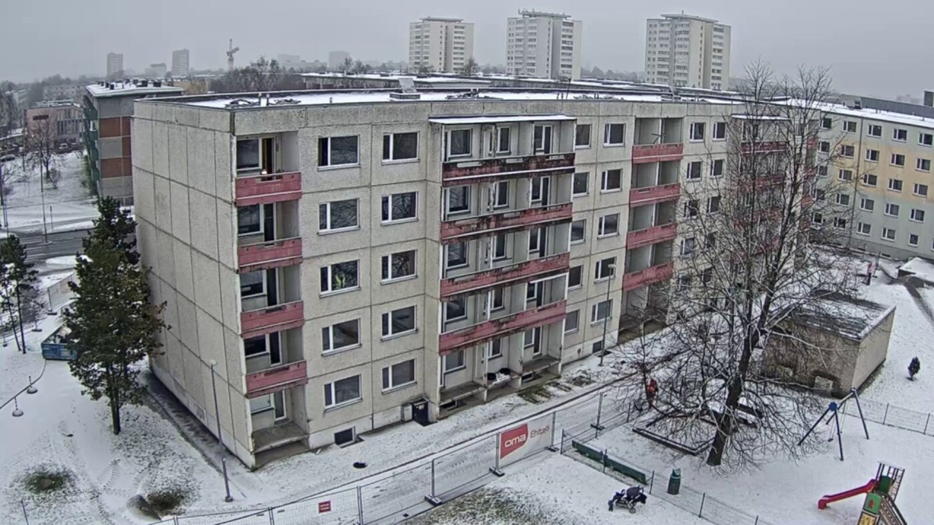
Sustainable innovation –
NZEB renovation case Estonia
NZEB Renovation with prefabricates elements

Slide 6
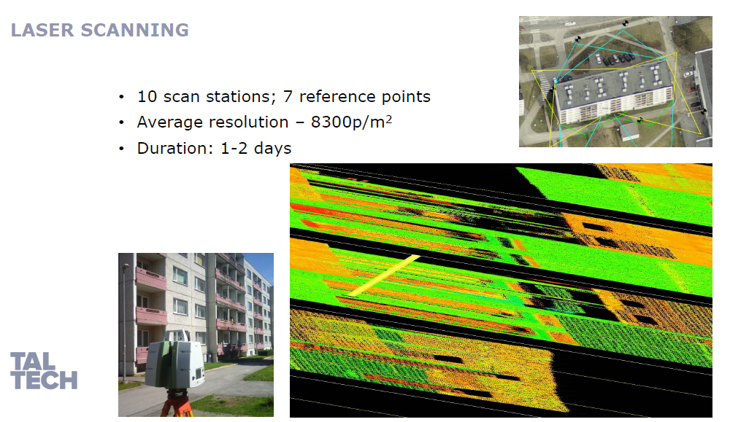
NZEB Renovation with prefabricates elements

Slide 7
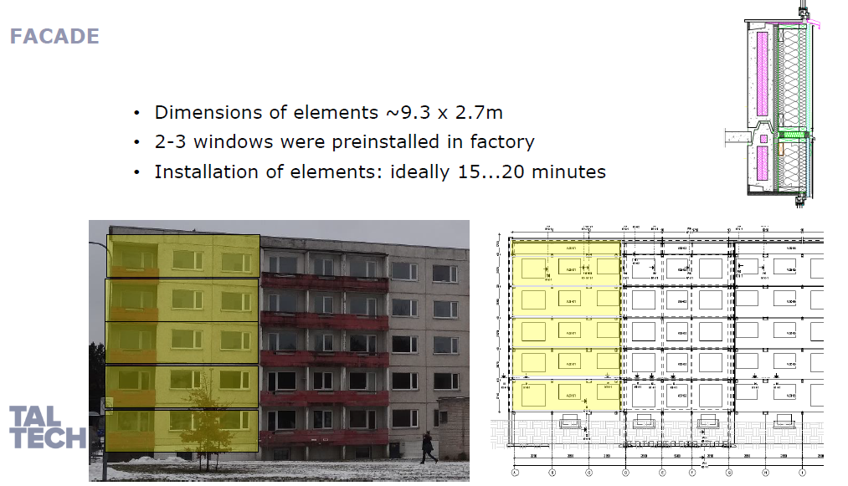
NZEB Renovation with prefabricates elements

Slide 8
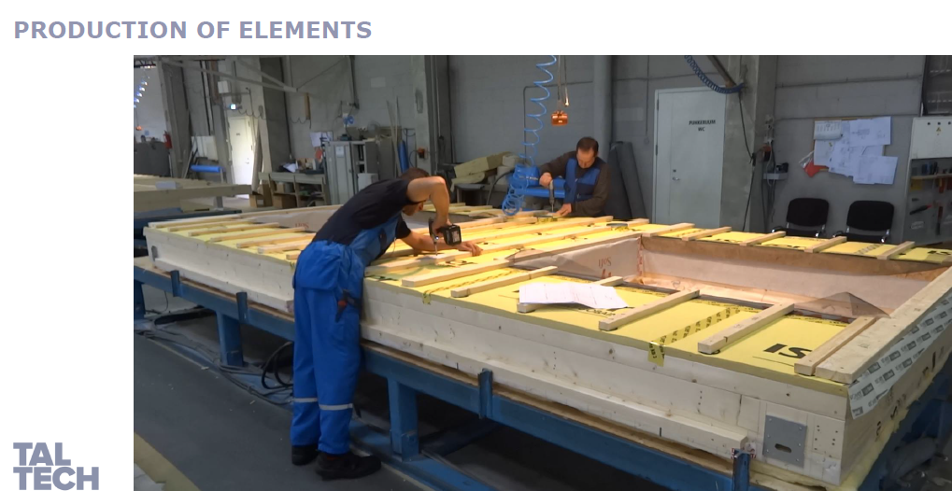
NZEB Renovation with prefabricates elements

Slide 9
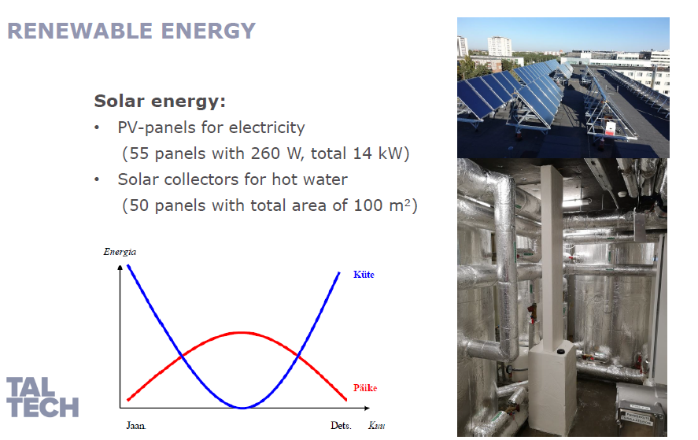
NZEB Renovation with prefabricates elements

Slide 10
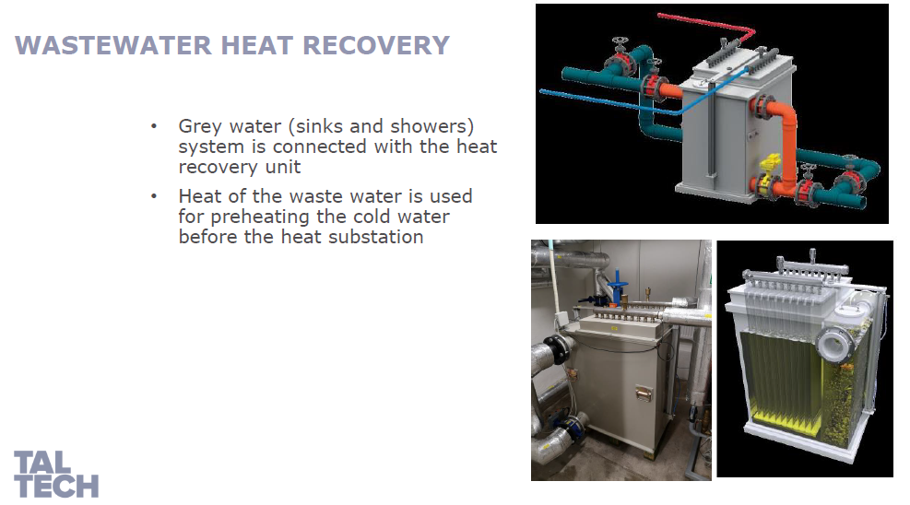
NZEB Renovation with prefabricates elements

Slide 11
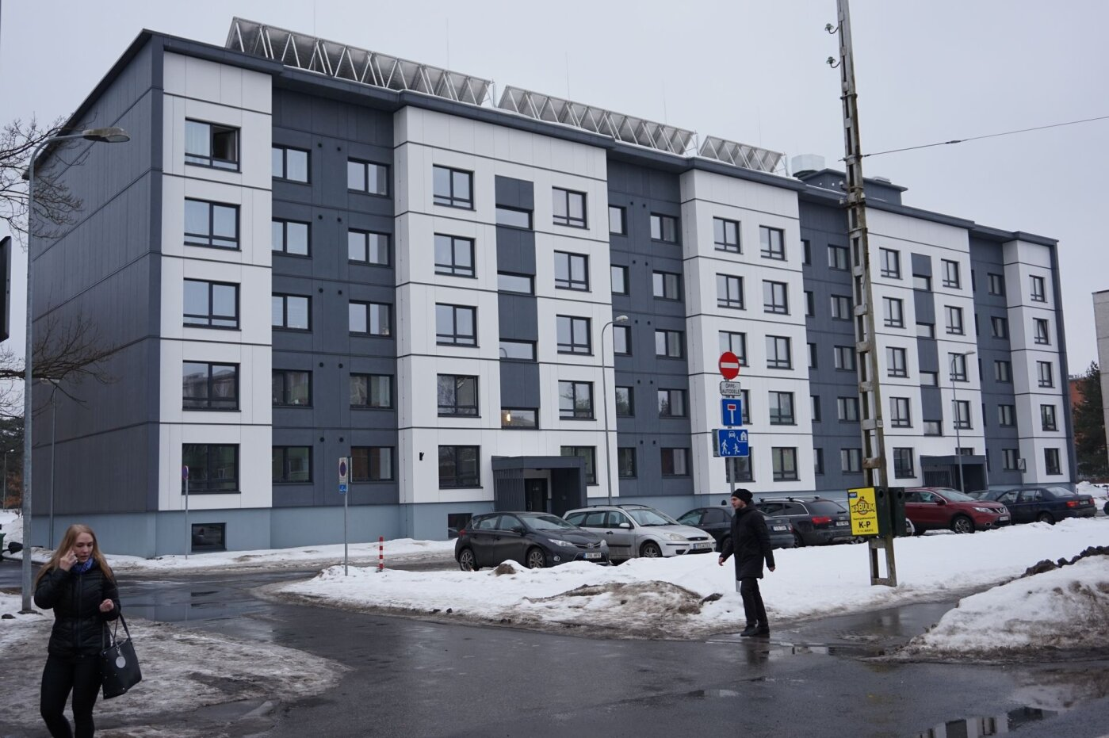
NZEB Renovation with prefabricates elements

Slide 12
Video

Slide 13
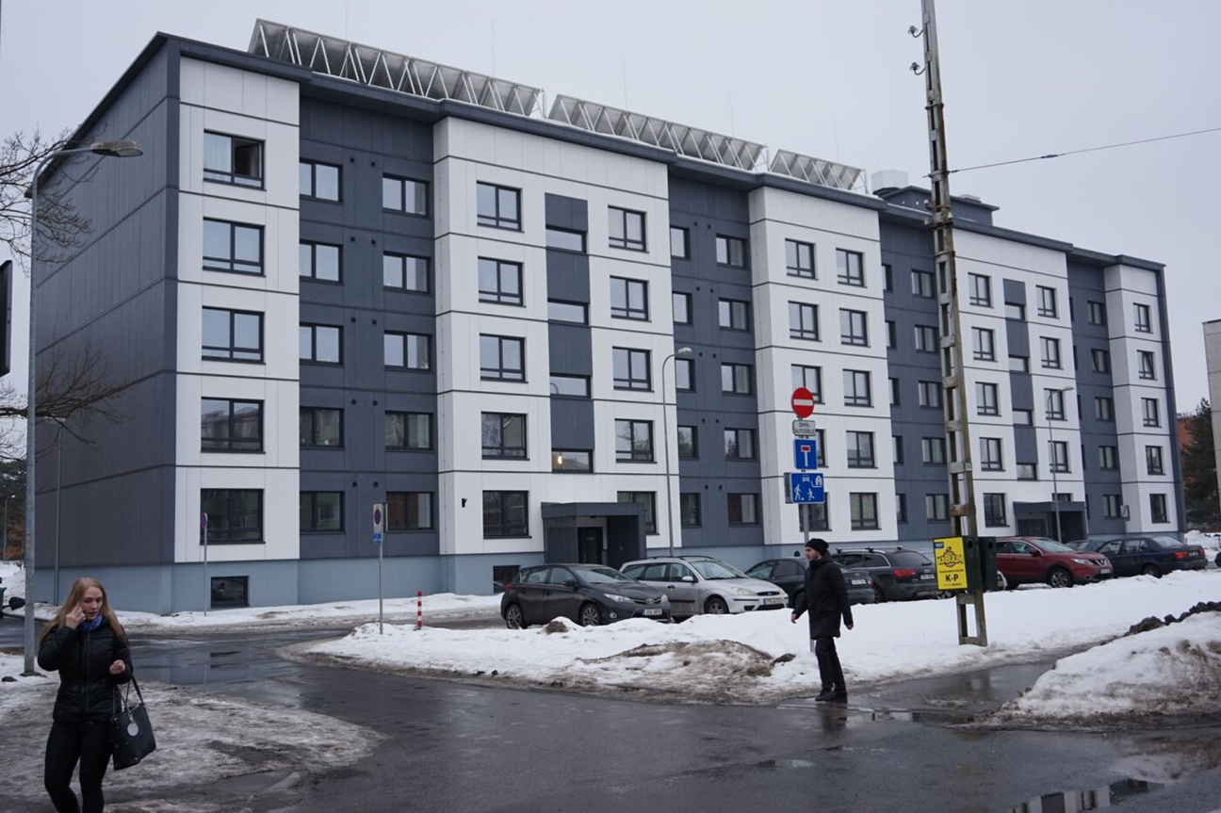

Let’s do it !
NZEB renovation in Europe

Slide 14
Thank you !
Eesti Korteriühistute Liit
Sakala 23A, 10141 Tallinn
tel. (+372) 6 275 740,
ekyl@ekyl.ee

